Slide 1
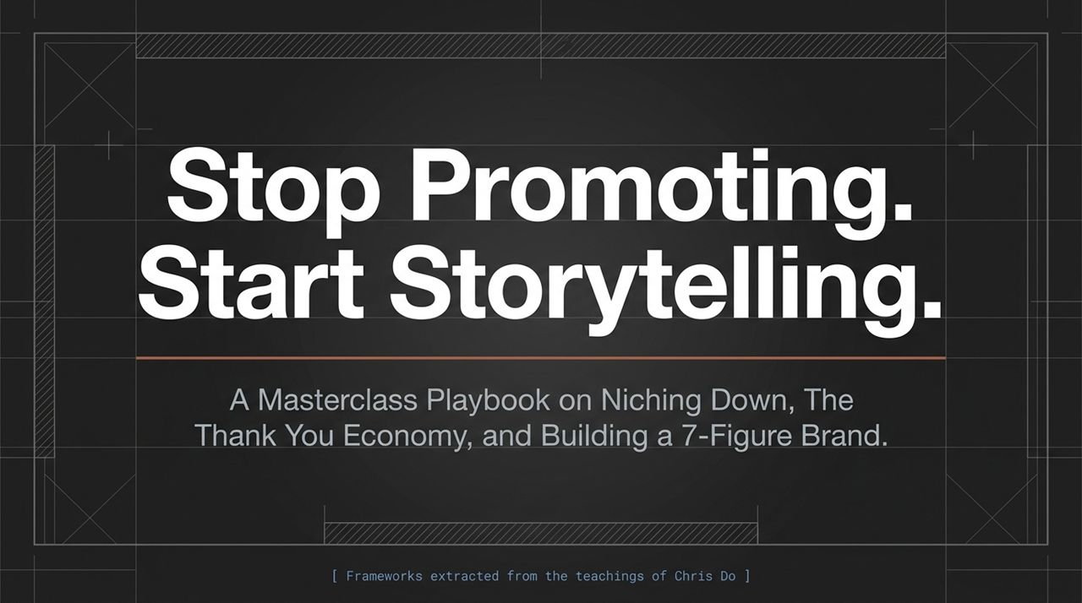
Notes:
Welcome, everyone. Today, we’re unpacking a fundamental shift in how we approach branding and business growth: moving away from self-promotional noise and stepping into transformational storytelling.
Historically, businesses have relied on traditional marketing—shouting about their features, shouting about their prices, and begging for attention. But today’s audience is completely immune to promotional noise. They don't buy what you do; they buy the transformation you make possible.
Over the next session, we’re going to walk through a masterclass playbook extracted directly from Chris Do's core frameworks. We will cover three vital pillars:
Closing the Imagination Gap through Storytelling
Transitioning from the Attention Economy to the Thank You Economy
Hyper-specializing your niche and pushing through The Dip to build a scalable, 7-figure brand.
Whether you're running a design agency, a software service, or an experiential travel business, these rules are universal. Let's dive in.
https://www.youtube.com/watch?v=FFPaVFBEIhI

Slide 2
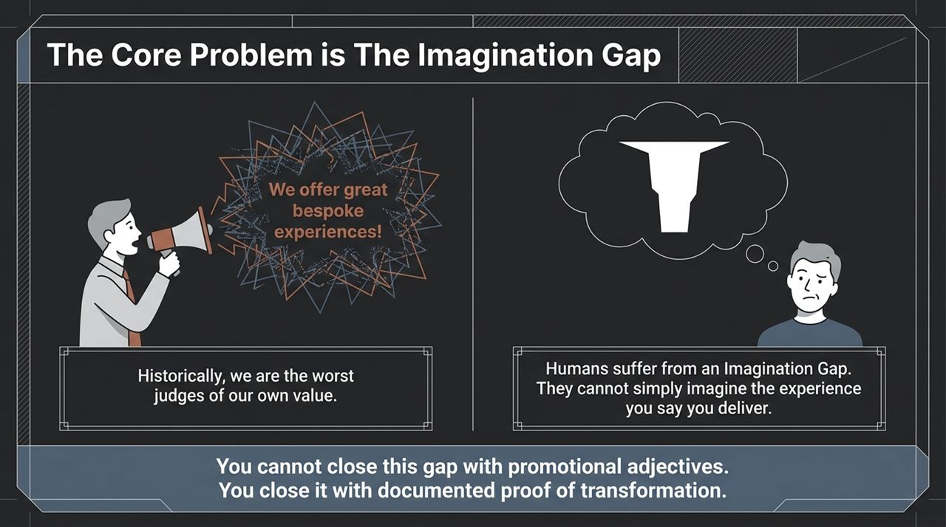
Notes:
Let's start by identifying the root problem most businesses face when trying to sell an experience or service.
Look at this scenario: a business owner stands with a megaphone shouting, We offer great bespoke experiences! What happens on the customer's side? Nothing. Why? Because humans suffer from an Imagination Gap. They cannot simply imagine the incredible experience or result you claim to deliver.
When you use broad, promotional adjectives like bespoke, high-end, or customized, they are completely abstract to the customer. Furthermore, as business owners, we are historically the worst judges of our own value. We assume people automatically understand how good we are because we know our work inside out. They don't.
You cannot close this Imagination Gap with adjectives or cheap claims. You can only close it with documented proof of transformation.
As Chris Do highlights, when clients can't visualize your impact, they say no. To make them say yes, you must give them undeniable, tangible proof—real videos, authentic photos, raw audio, and video testimonials showing real people undergoing that exact shift. Stop telling them how good you are; show them proof until the gap disappears.

Slide 3
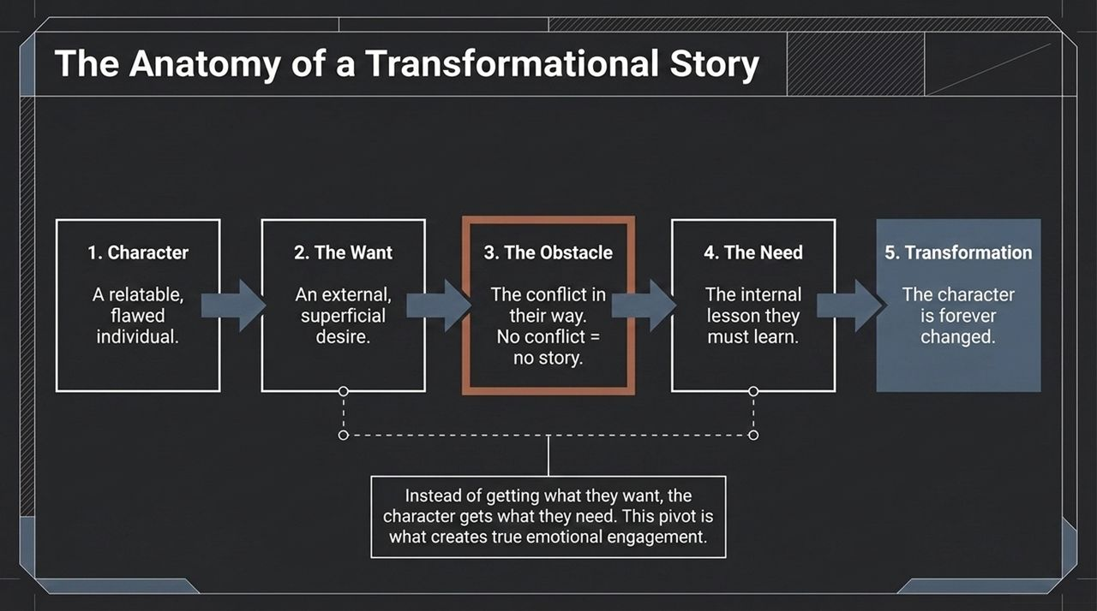
Notes:
To show that proof effectively, you must understand the anatomy of a story. Storytelling isn't just a buzzword—it is a proven structural formula that humans have responded to for thousands of years.
Every compelling narrative follows a 5-step path:
The Character: A relatable, flawed individual. If the character is perfect, no one cares.
The Want: Their external, superficial desire (e.g., wanting to be popular, wanting a trip, wanting a new tool).
The Obstacle: The conflict in their way. Remember Robert McKee’s famous principle: No conflict = no story.
The Need: The internal lesson they must learn.
The Transformation: The character emerges forever changed.
Here is the key pivot every marketer misses: Instead of getting what they want, the character gets what they need.
In classic storytelling—whether it's Romeo & Juliet or a customer case study—the character starts with an external goal (the Want). But when they hit an obstacle, they are forced to confront an internal mindset shift (the Need). That emotional pivot from external desire to internal growth is what creates true emotional engagement and makes your content unforgettable.

Slide 4
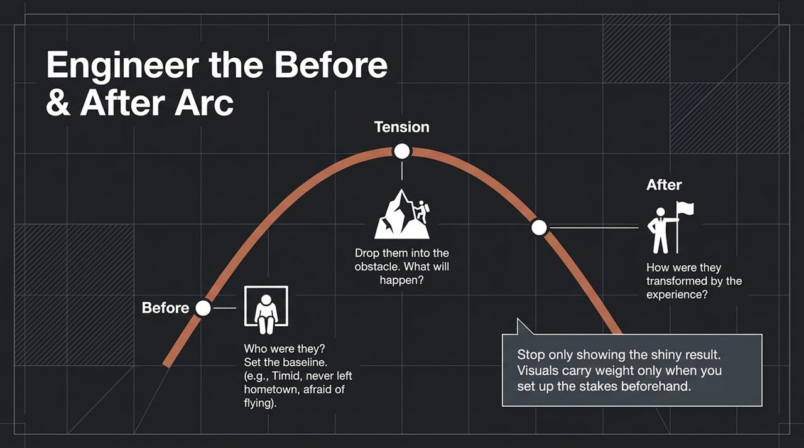
Notes:
Now, how do we apply this storytelling structure to our visual content and case studies? By engineering a dramatic Before & After Arc.
Most marketers make the mistake of only showing the shiny result—a beautiful photo of a mountain summit or a polished logo. But visuals carry weight only when you set up the stakes beforehand.
The Before (Setting the Baseline): Who were they before encountering you? Were they timid? Had they never left their hometown? Were they afraid of flying or drowning in tech chaos? Establish their baseline vulnerabilities.
The Tension (Dropping into the Obstacle): Place them right into the challenge. Will they make it? How will they navigate the storm? This tension creates suspense and forces the viewer to stay tuned.
The After (The Transformation): Show how they were fundamentally changed by the experience.
If you show a Navy SEAL completing an obstacle course, it's boring because we expect them to win. But if you show someone who was timid, terrified of cold weather, and dropped into an icy glacier hike in Iceland, every step carries dramatic weight. Set up the contrast before you reveal the outcome.

Slide 5
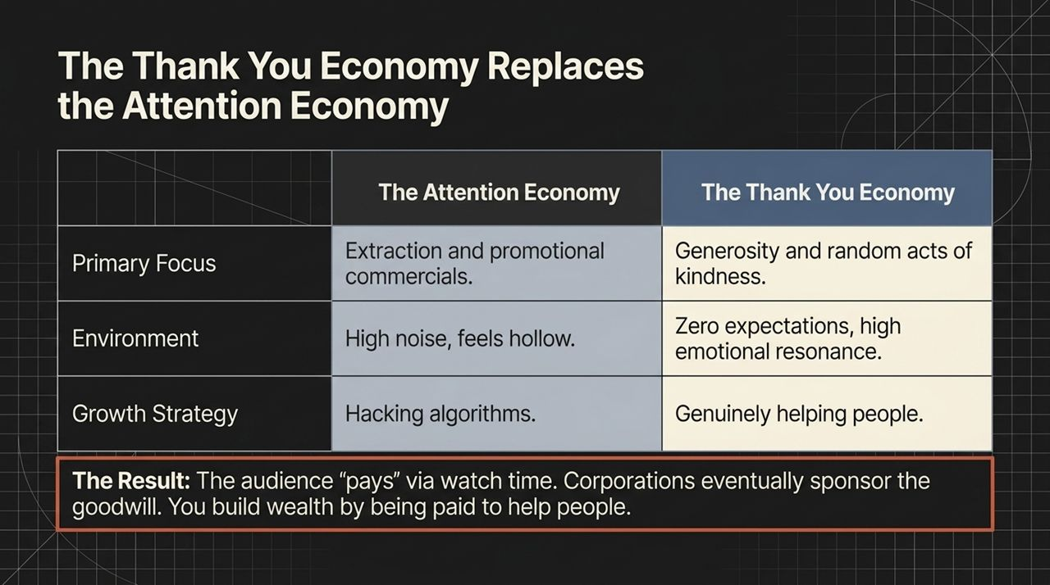
Notes:
Let's contrast two major business models: The Attention Economy versus The Thank You Economy.
In the Attention Economy, the focus is on extraction and promotional commercials. Companies try to hack algorithms, interrupt people, and create high noise. It feels hollow, and consumers instantly tune it out.
In contrast, The Thank You Economy is built on generosity and random acts of kindness. You enter an environment of zero expectations and high emotional resonance. Instead of trying to trick the algorithm, your growth strategy is simple: genuinely help people.
Think about popular creators who clean overgrown lawns for free or give shoes to those in need. They aren't in the lawn-mowing or shoe business; they are in the helping people business. The audience pays them via watch time and emotional loyalty, and eventually, major corporations step in to sponsor that goodwill.
If you make a subtle mindset pivot from What can I sell? to How can I help?, you unlock a model where you build social capital, attract corporate sponsors, and ultimately get paid generously just to help people.

Slide 6
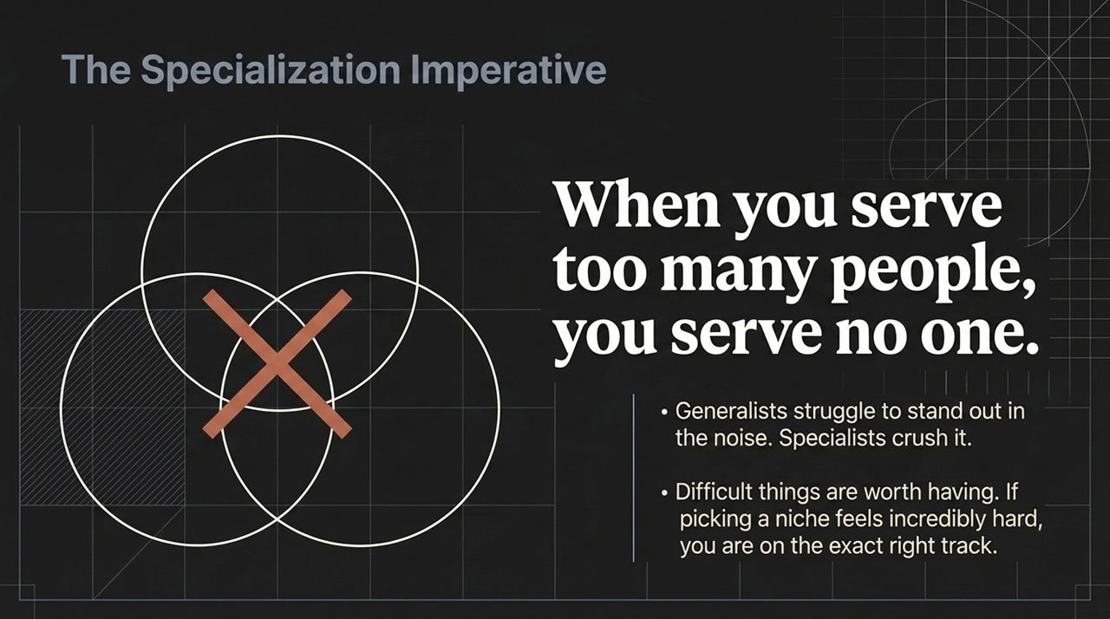
Notes:
Now that we understand story and value, let's talk about positioning: When you serve too many people, you serve no one.
Generalists constantly struggle to stand out in a crowded market. They fight over price, deal with high client churn, and get lost in the noise. Specialists, on the other hand, crush it.
When you specialize, you become the undisputed authority for a specific group. You no longer compete with thousands of general practitioners; you become the surgeon people seek out and pay premium rates for.
Choosing a niche feels uncomfortable. It triggers FOMO—the fear of missing out on all the other potential clients. But remember this lesson: Difficult things are worth having. If picking a niche feels incredibly hard, that's proof you are on the exact right track. Ease creates low barriers to entry and high competition; difficulty creates defensibility and authority.

Slide 7
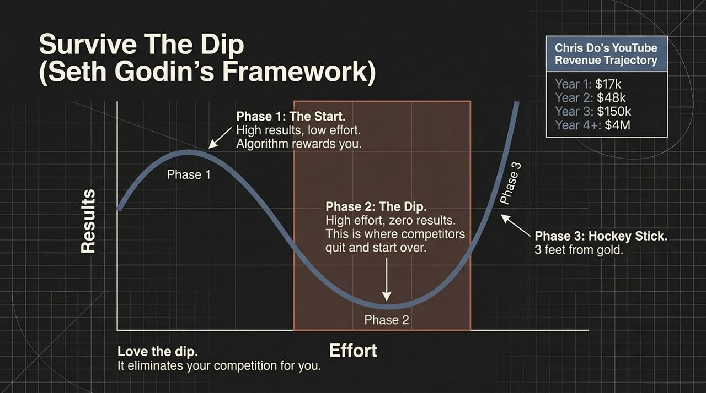
Notes:
When you pivot to a specialized niche or launch a new initiative, you will inevitably encounter The Dip, a framework conceptualized by Seth Godin.
Every journey follows three distinct phases:
Phase 1 (The Start): Low effort, high initial excitement/results. Platforms and algorithms often reward novelty.
Phase 2 (The Dip): High effort, zero noticeable results. This is the long grind where it feels like you're shouting into an empty room. This is where 99% of your competitors quit and reset.
Phase 3 (The Hockey Stick Growth): Exponential payoff right when you are three feet from gold.
Look at Chris Do’s own YouTube revenue trajectory as a real-world example:
Year 1: $17,000 (while running a multi-million-dollar agency)
Year 2: $48,000 (still in the grind)
Year 3: $150,000 (3x momentum starts)
Year 4+: $4,000,000+ per year
Most people give up during Phase 2 and hop to a new strategy, resetting their journey back to zero. Learn to love the dip. The dip is not your enemy; it is your filter. It eliminates your competition for you.

Slide 8
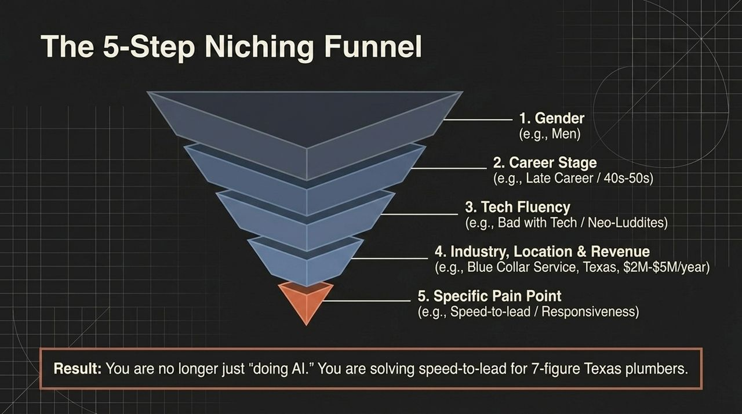
Notes:
If you're wondering how to narrow your focus without getting stuck, use this practical 5-Step Niching Funnel. Instead of making a random guess, filter your market down layer by layer:
Gender: Narrow down to a primary demographic (e.g., Men).
Career Stage: Focus on a specific age or stage (e.g., Late Career / 40s–50s).
Tech Fluency: Identify their comfort level with modern tools (e.g., Bad with Tech / Neo-Luddites).
Industry, Location & Revenue: Add geographic and commercial constraints (e.g., Blue-collar service providers in Texas earning $2M–$5M/year).
Specific Pain Point: Isolate their single biggest operational headache (e.g., Speed-to-lead / Responsiveness).
The Result: You are no longer just a vague consultant doing AI or tech automation. You are now the leading expert solving speed-to-lead issues for 7-figure Texas plumbers.
Notice how clear that positioning becomes. When a prospect in that exact bucket sees your offer, they don't compare you to generalists—they hire you immediately because you speak their exact language.

Slide 9
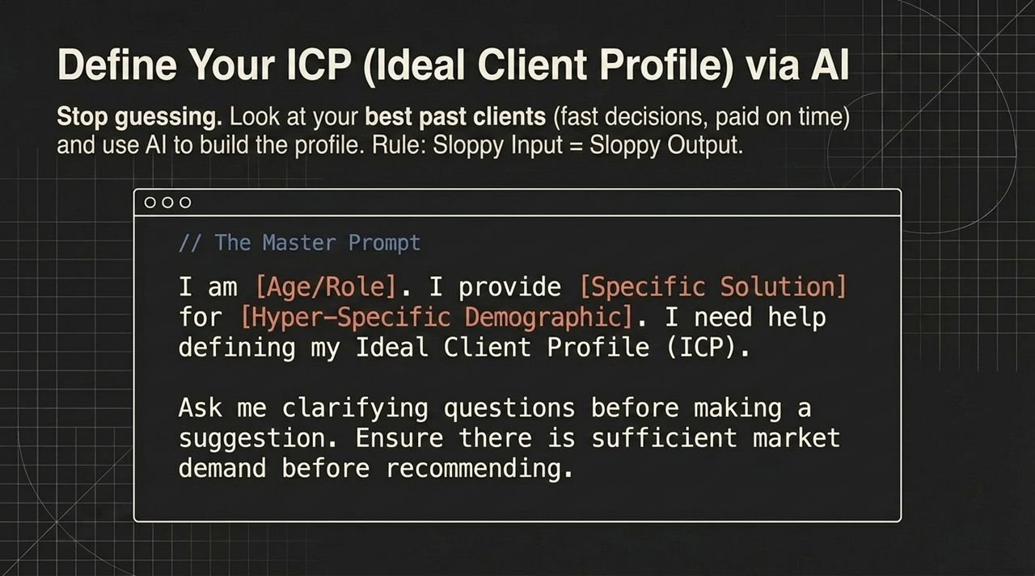
Notes:
Once you understand the 5-step funnel, you can leverage AI tools like Claude to define your Ideal Client Profile (ICP) in minutes. Stop guessing blindly. Look at your past history: who were the clients that paid on time, made fast decisions, and were a joy to work with?
To get high-quality output from AI, remember the Golden Rule: Sloppy Input = Sloppy Output.
Here is the Master Prompt to use:
I am [Age/Role]. I provide [Specific Solution] for [Hyper-Specific Demographic]. I need help defining my Ideal Client Profile (ICP). Ask me clarifying questions before making a suggestion. Ensure there is sufficient market demand before recommending.
Notice two key elements in this prompt:
You force the AI to ask you clarifying questions first.
You require it to validate market demand before giving a final recommendation.
This interactive approach yields an accurate, actionable ICP that you can immediately test in the real world.

Slide 10
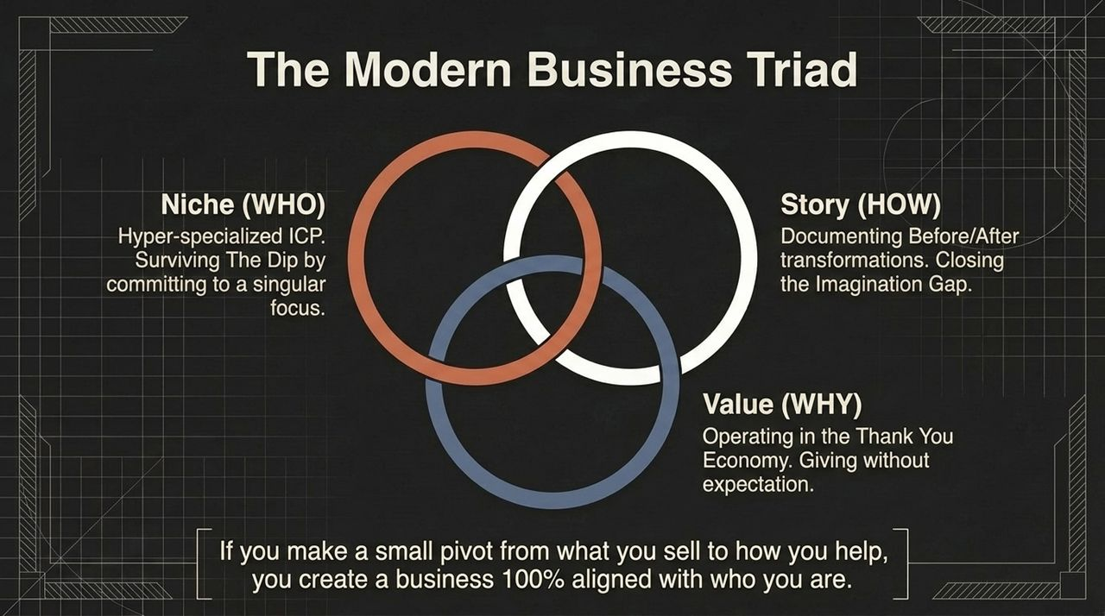
Notes:
To synthesize everything we’ve covered so far, let's look at The Modern Business Triad. Sustainable 7-figure brands operate at the exact intersection of three core elements:
Niche (WHO): A hyper-specialized ICP. It’s about committing to a singular focus and having the grit to survive The Dip.
Story (HOW): Documenting real Before/After transformations to close the Imagination Gap.
Value (WHY): Operating in the Thank You Economy by giving uncompromised value without immediate expectation of extraction.
When all three circles overlap, magic happens. You stop chasing leads, stop discounting prices, and stop competing in red oceans.
If you make a subtle pivot from what you sell to how you help, you will build a business that is not only highly profitable, but 100% aligned with who you are.

Slide 11
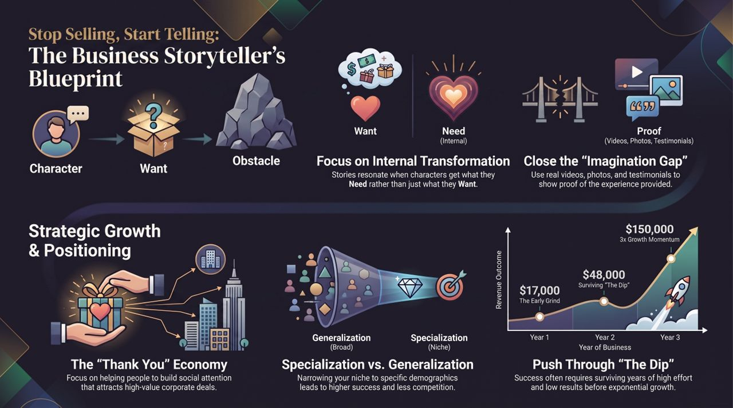
Notes:
Slide 11 brings our entire framework together into a single, comprehensive summary map—The Business Storyteller's Blueprint.
Let's review the journey we've mapped out:
Strategic Story Structure: Every brand story starts with a Character who has an external Want. They hit an Obstacle, force an internal pivot to uncover what they Need, and achieve internal transformation.
Closing the Imagination Gap: Use undeniable proof—videos, photos, and authentic testimonials—to show, not tell.
The Thank You Economy: Generosity creates social attention. As your audience trusts you, high-value brand deals and premium clients follow naturally.
Specialization over Generalization: Move from a broad audience to a narrow niche to eliminate competition and increase pricing power.
Pushing Through The Dip: Realize that exponential growth ($17k → $48k → $150k+) requires surviving the grind while everyone else quits.
Final Message to the Audience: Stop selling products. Start telling transformation stories. Specialize your offer, build in public, help people selflessly, and the business growth will follow naturally. Thank you!

